Slide 2

Excel to R
Matt Farrow, Southern Methodist University (@_MattFarrow)
Artwork: Allison Horst (@)

Slide 3
Considering R
Pros
Reproducible
Free
Powerful
Community
Flexibility
Cons
Programming language
Learning curve
Time
Institutional support

Slide 4

Artwork: Khadeeja

Slide 5
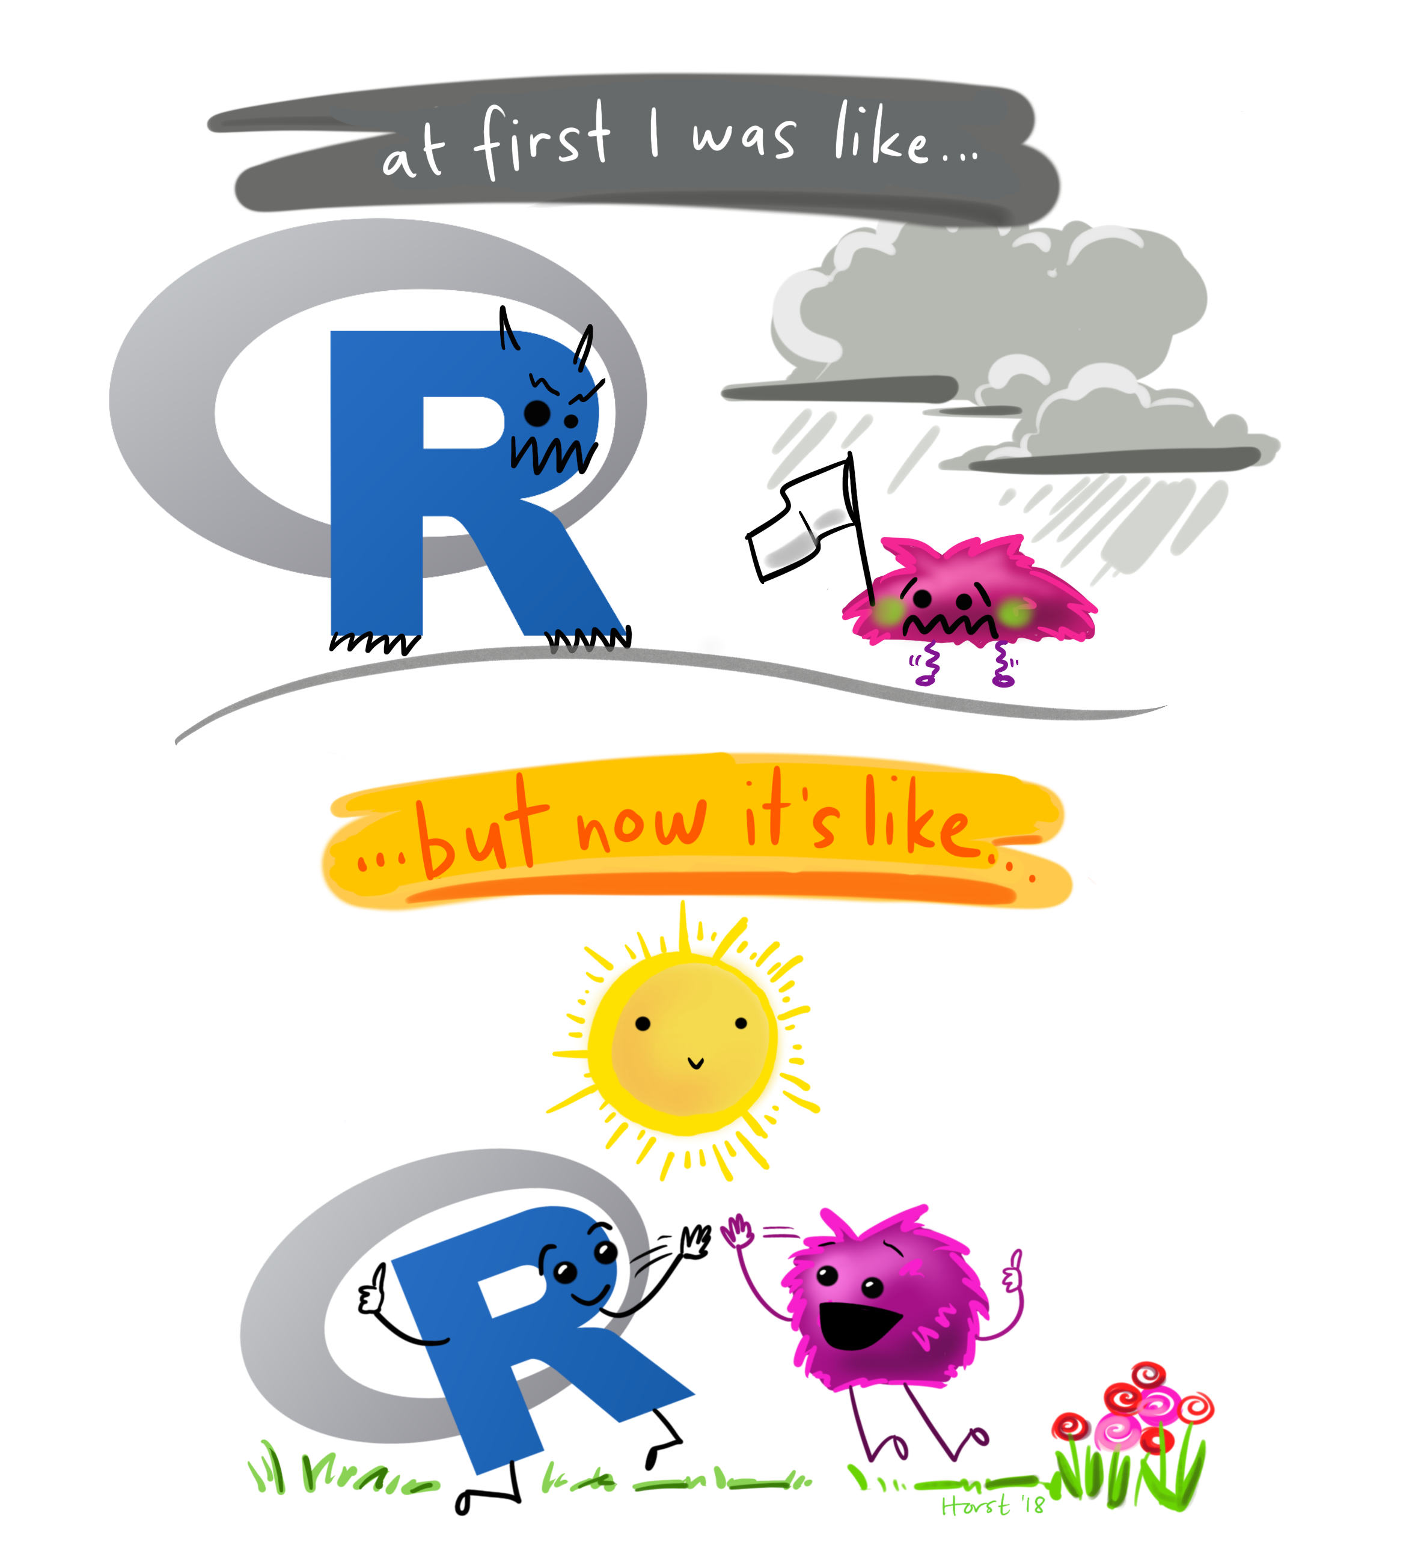
I Can’t Do This!
Start small
Find a problem
Baby steps
Look how far you’ve come!

Slide 6
Getting Started
Downloading the Software, Orienting Yourself

Slide 7
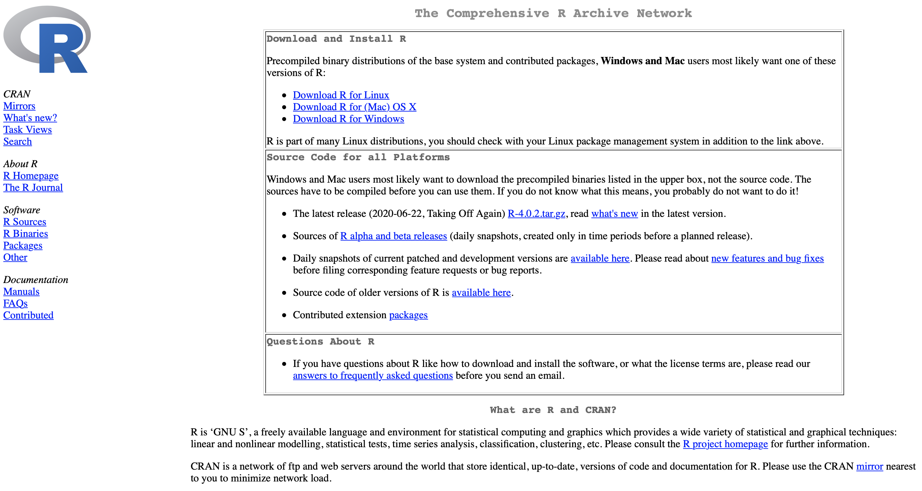
Downloading R (CRAN)

Slide 8
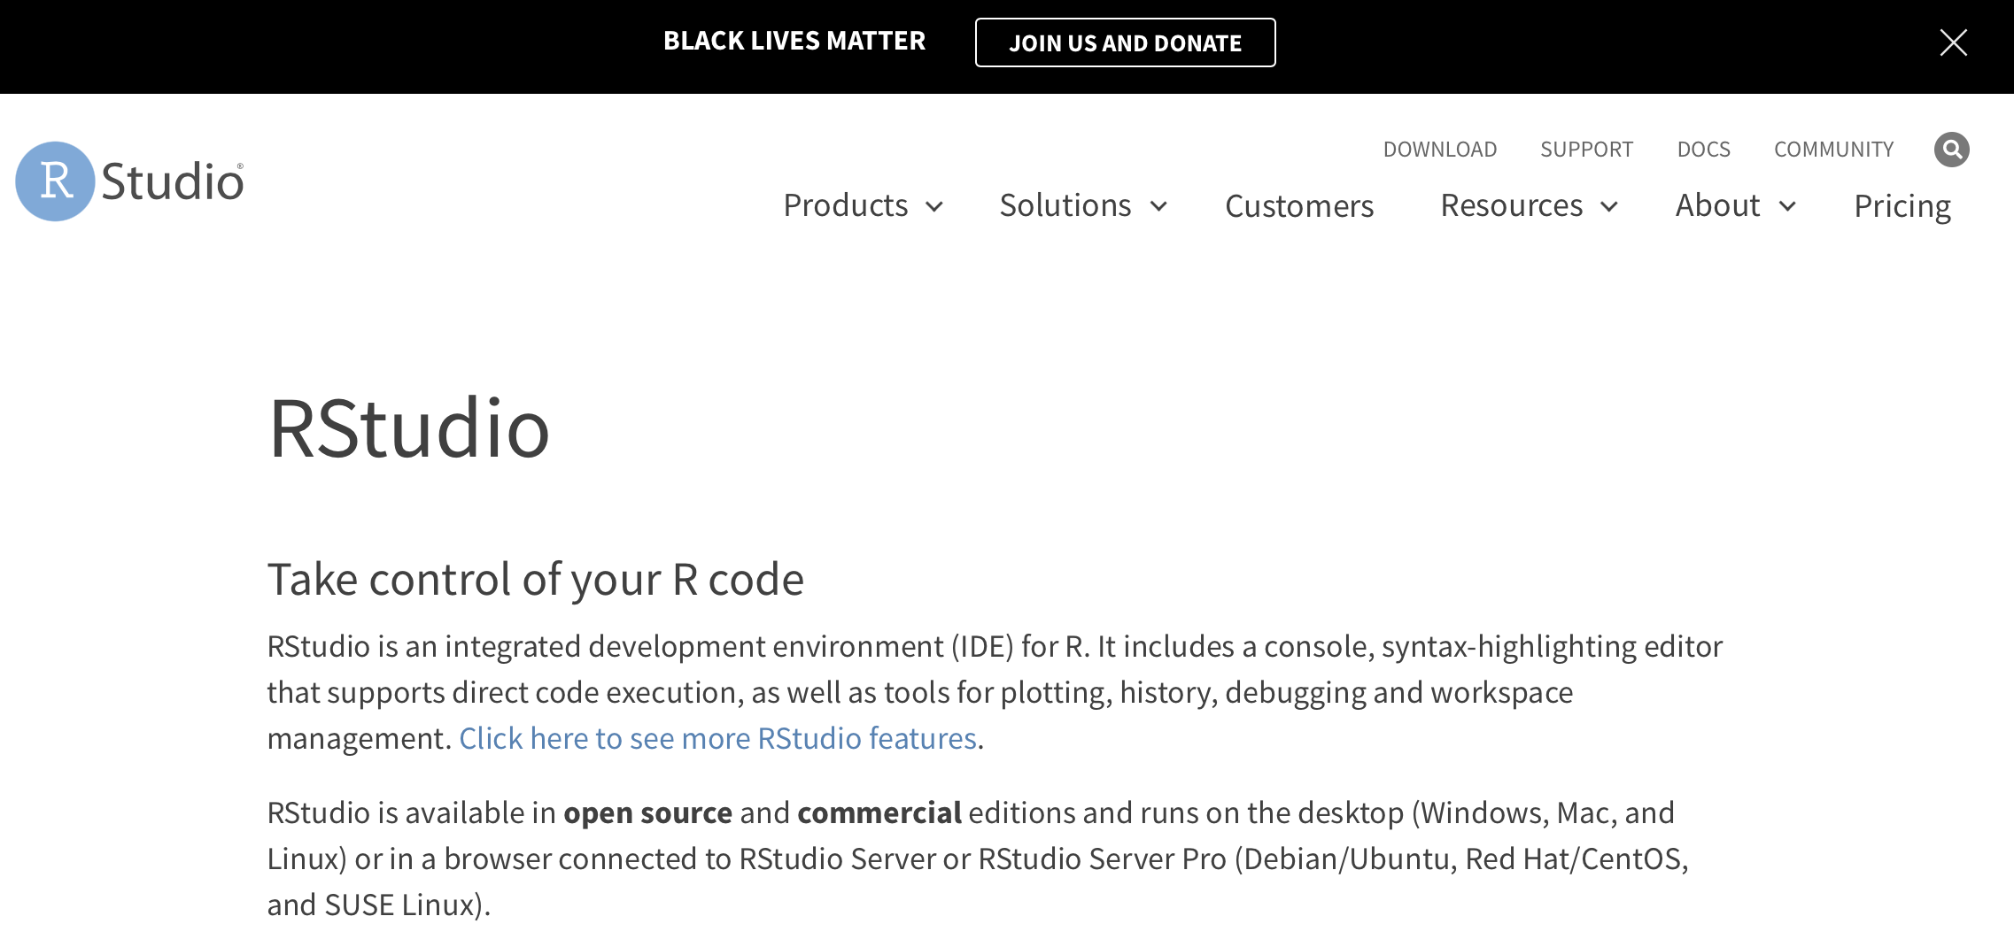
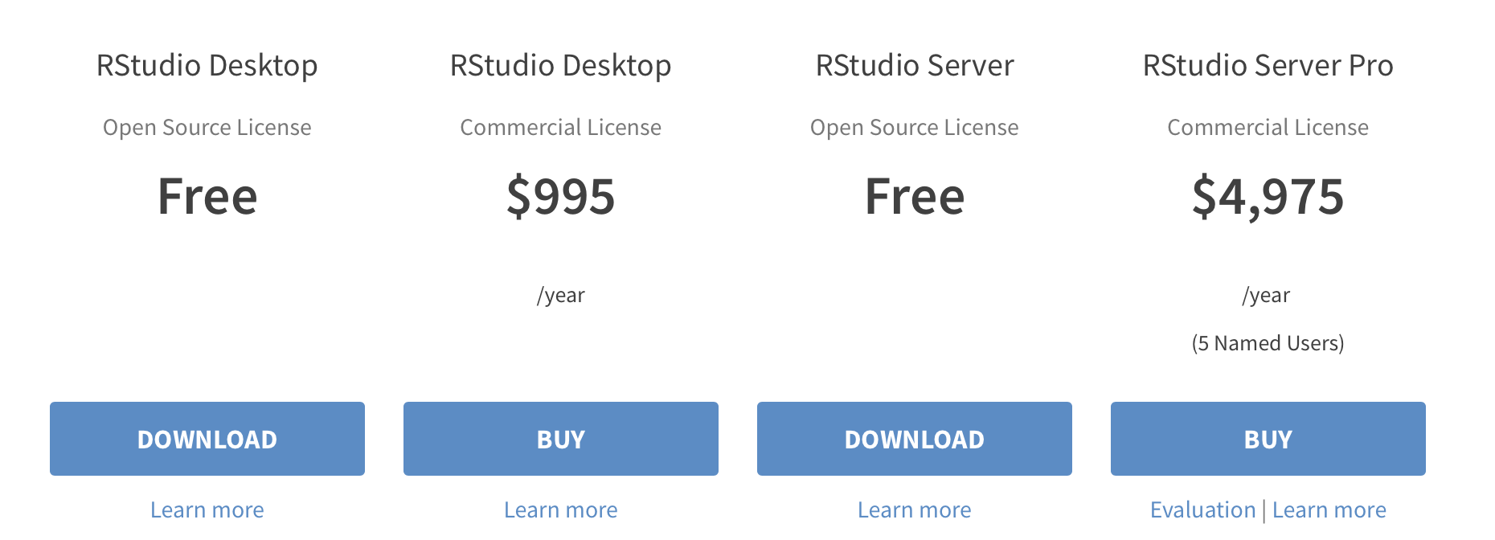
Downloading RStudio

Slide 9
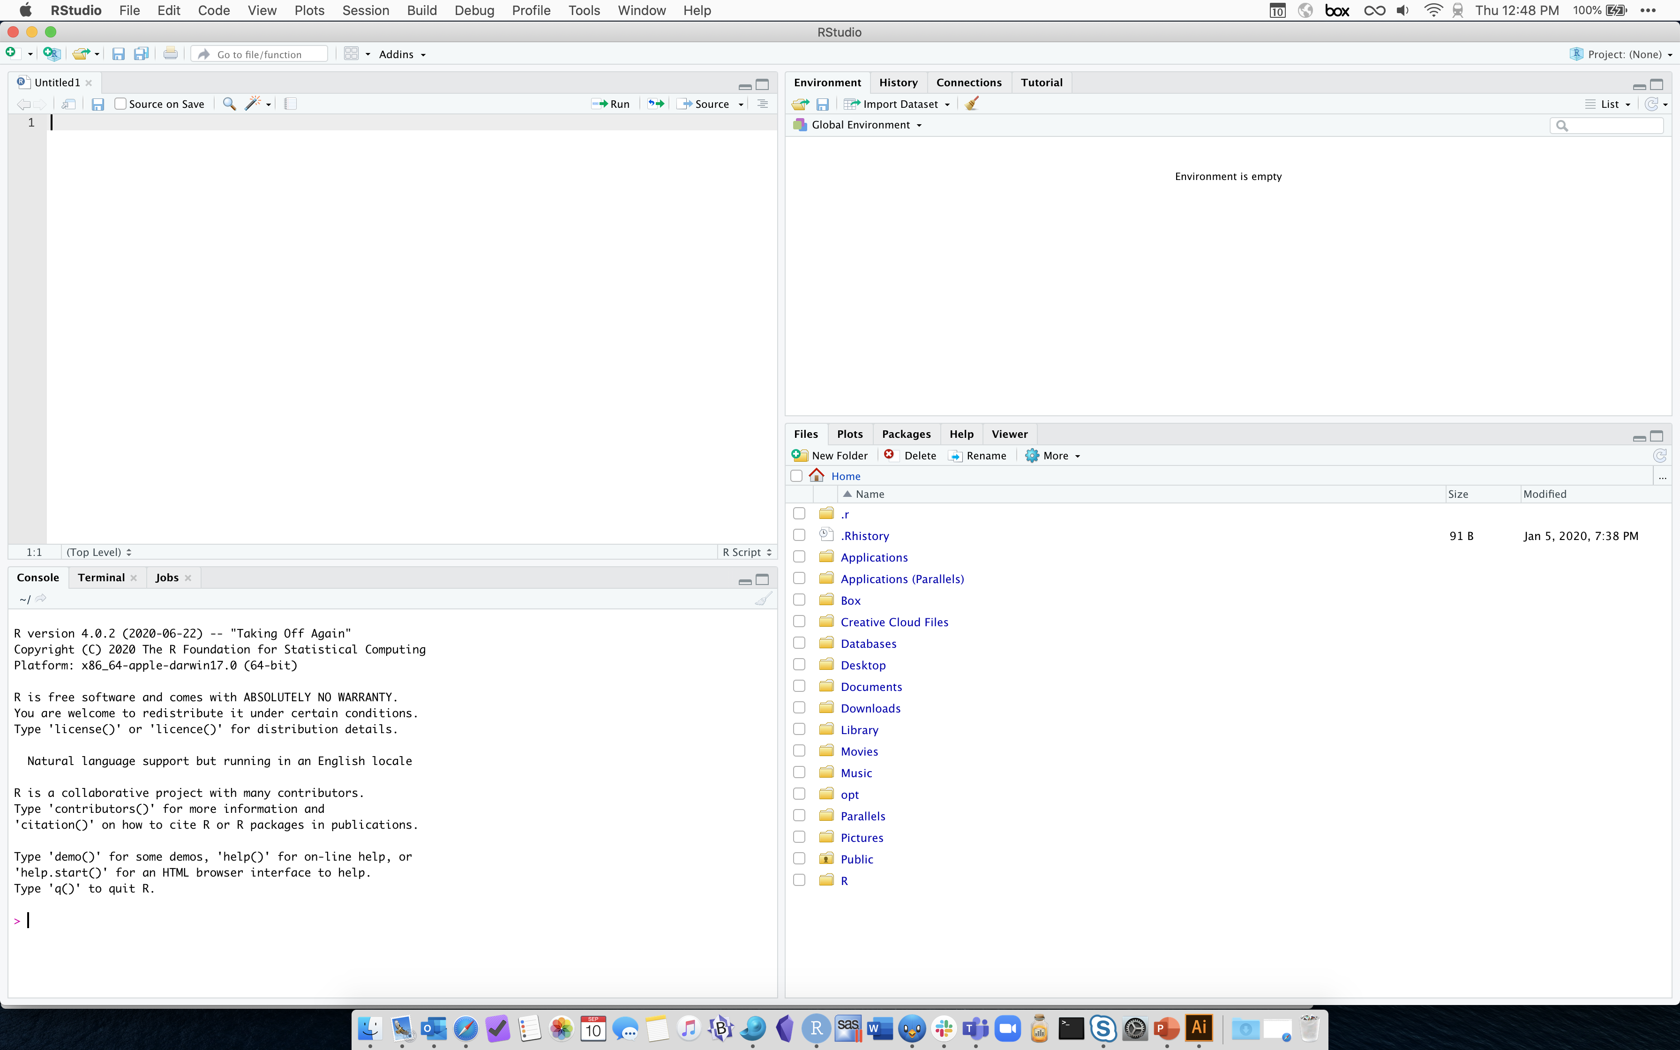

Slide 10
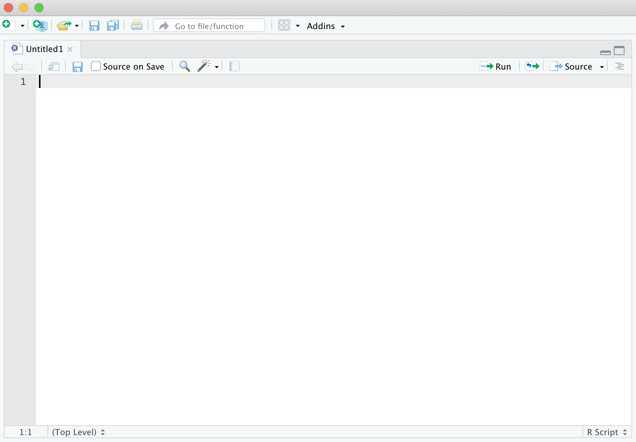
Rstudio Layout

Slide 11
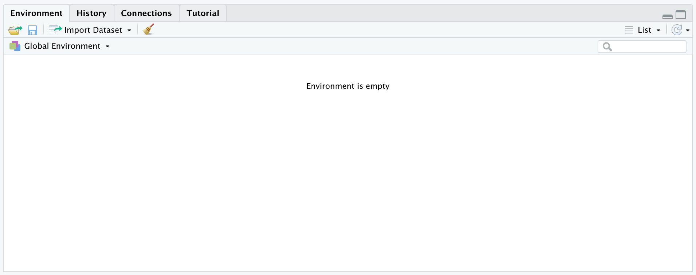
Rstudio Layout

Slide 12
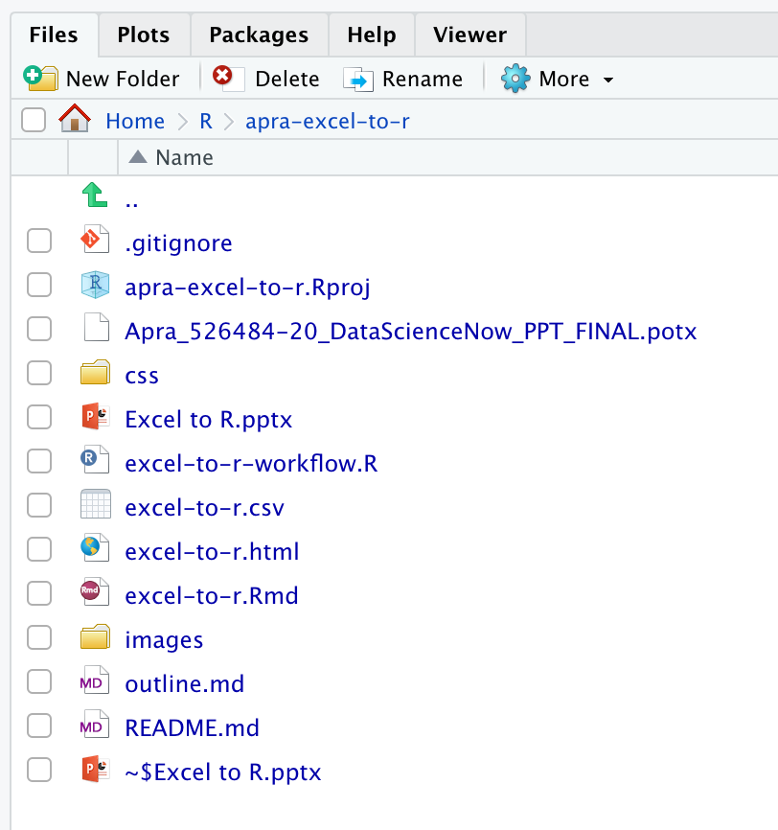
Rstudio Layout

Slide 13
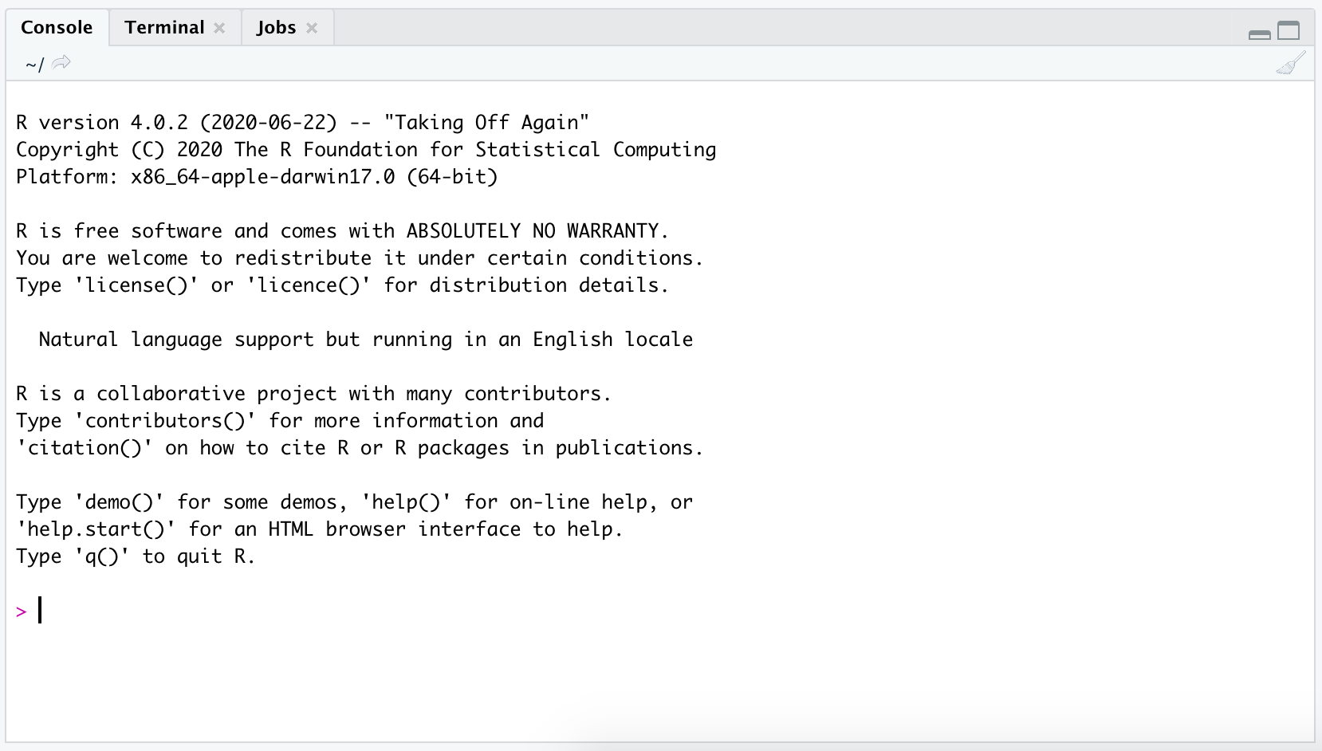
Rstudio Layout

Slide 14
Let’s Dive In
Switch over to … to continue the workshop.

Slide 15
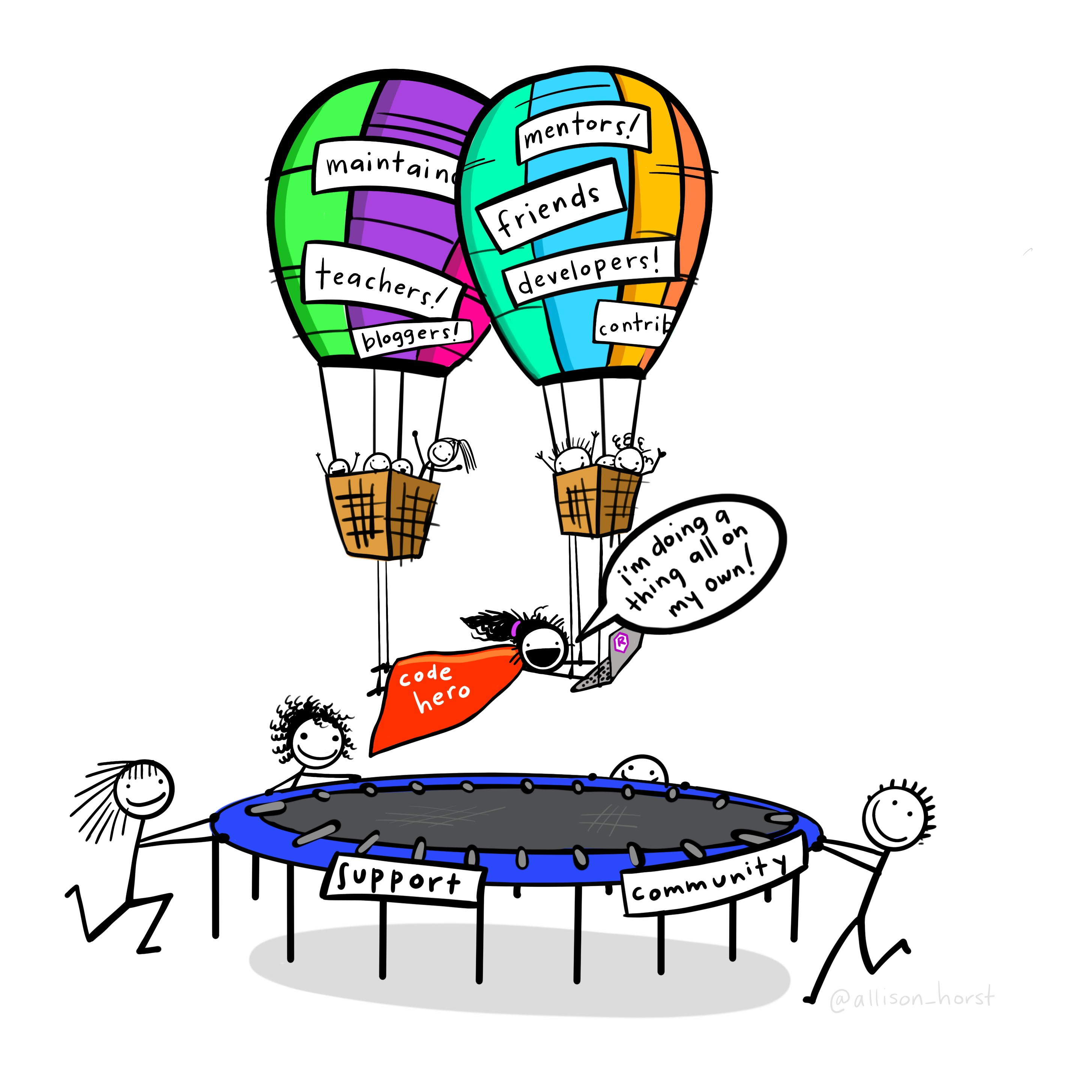
Learning Resources
R for Data Science (R4DS)
Book by Hadley Wickham and
Garrett Grolemund
R for Excel Users
Blog post by Gordon Shotwell
R for Excel Users
RStudio Conference 2020 workshop
by Julia Lowndes and Allison Horst
#rstats
#tidytuesday

Slide 16
Questions?
Matt Farrow
@_MattFarrow

